Slide 1
DPM Meeting 3
Mechanical Component Prototyping

Slide 2
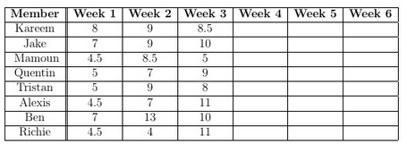
Budget
Week 3:
Kareem
Finalizing main software algorithm
Construct some mechanical designs
Gantt and Presentation
Jake
Worked on Localization, Hardware and WiFi Test Documents
Built the static collector
Tristan & Alexis:
Localization testing
Updated class hierarchy/algorithm
Mamoun & Richie:
Hardware tests (Rear wheel vs Front wheel)
Various caster wheel designs
Quentin & Ben:
Building collectors, grabbers and hybrids
Testing the designs

Slide 3
Gantt Chart

Slide 4
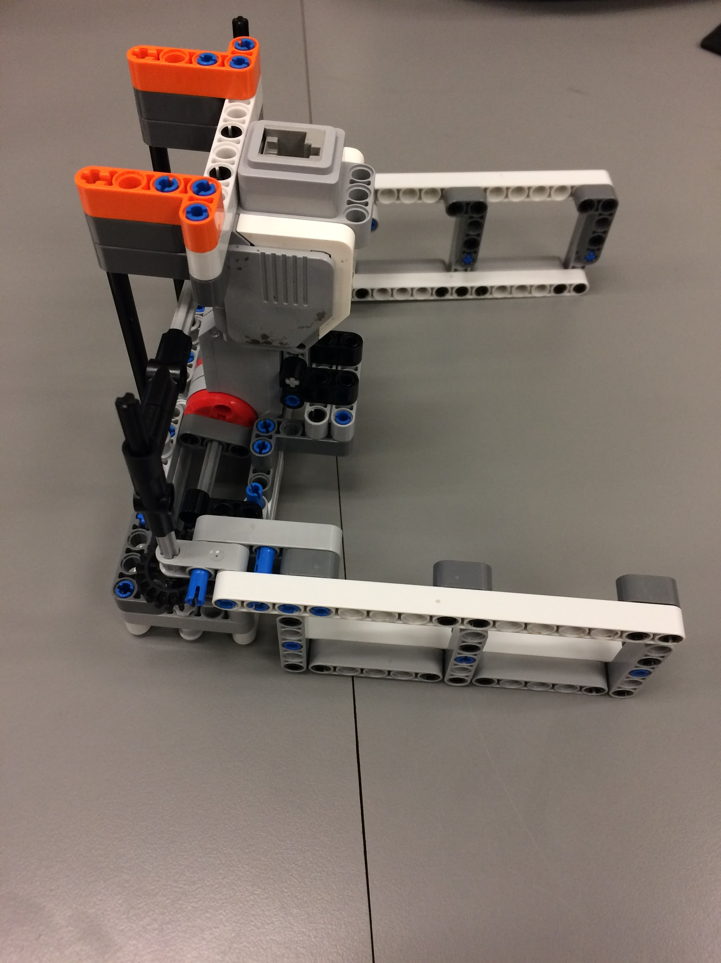
Hybrids

Slide 5
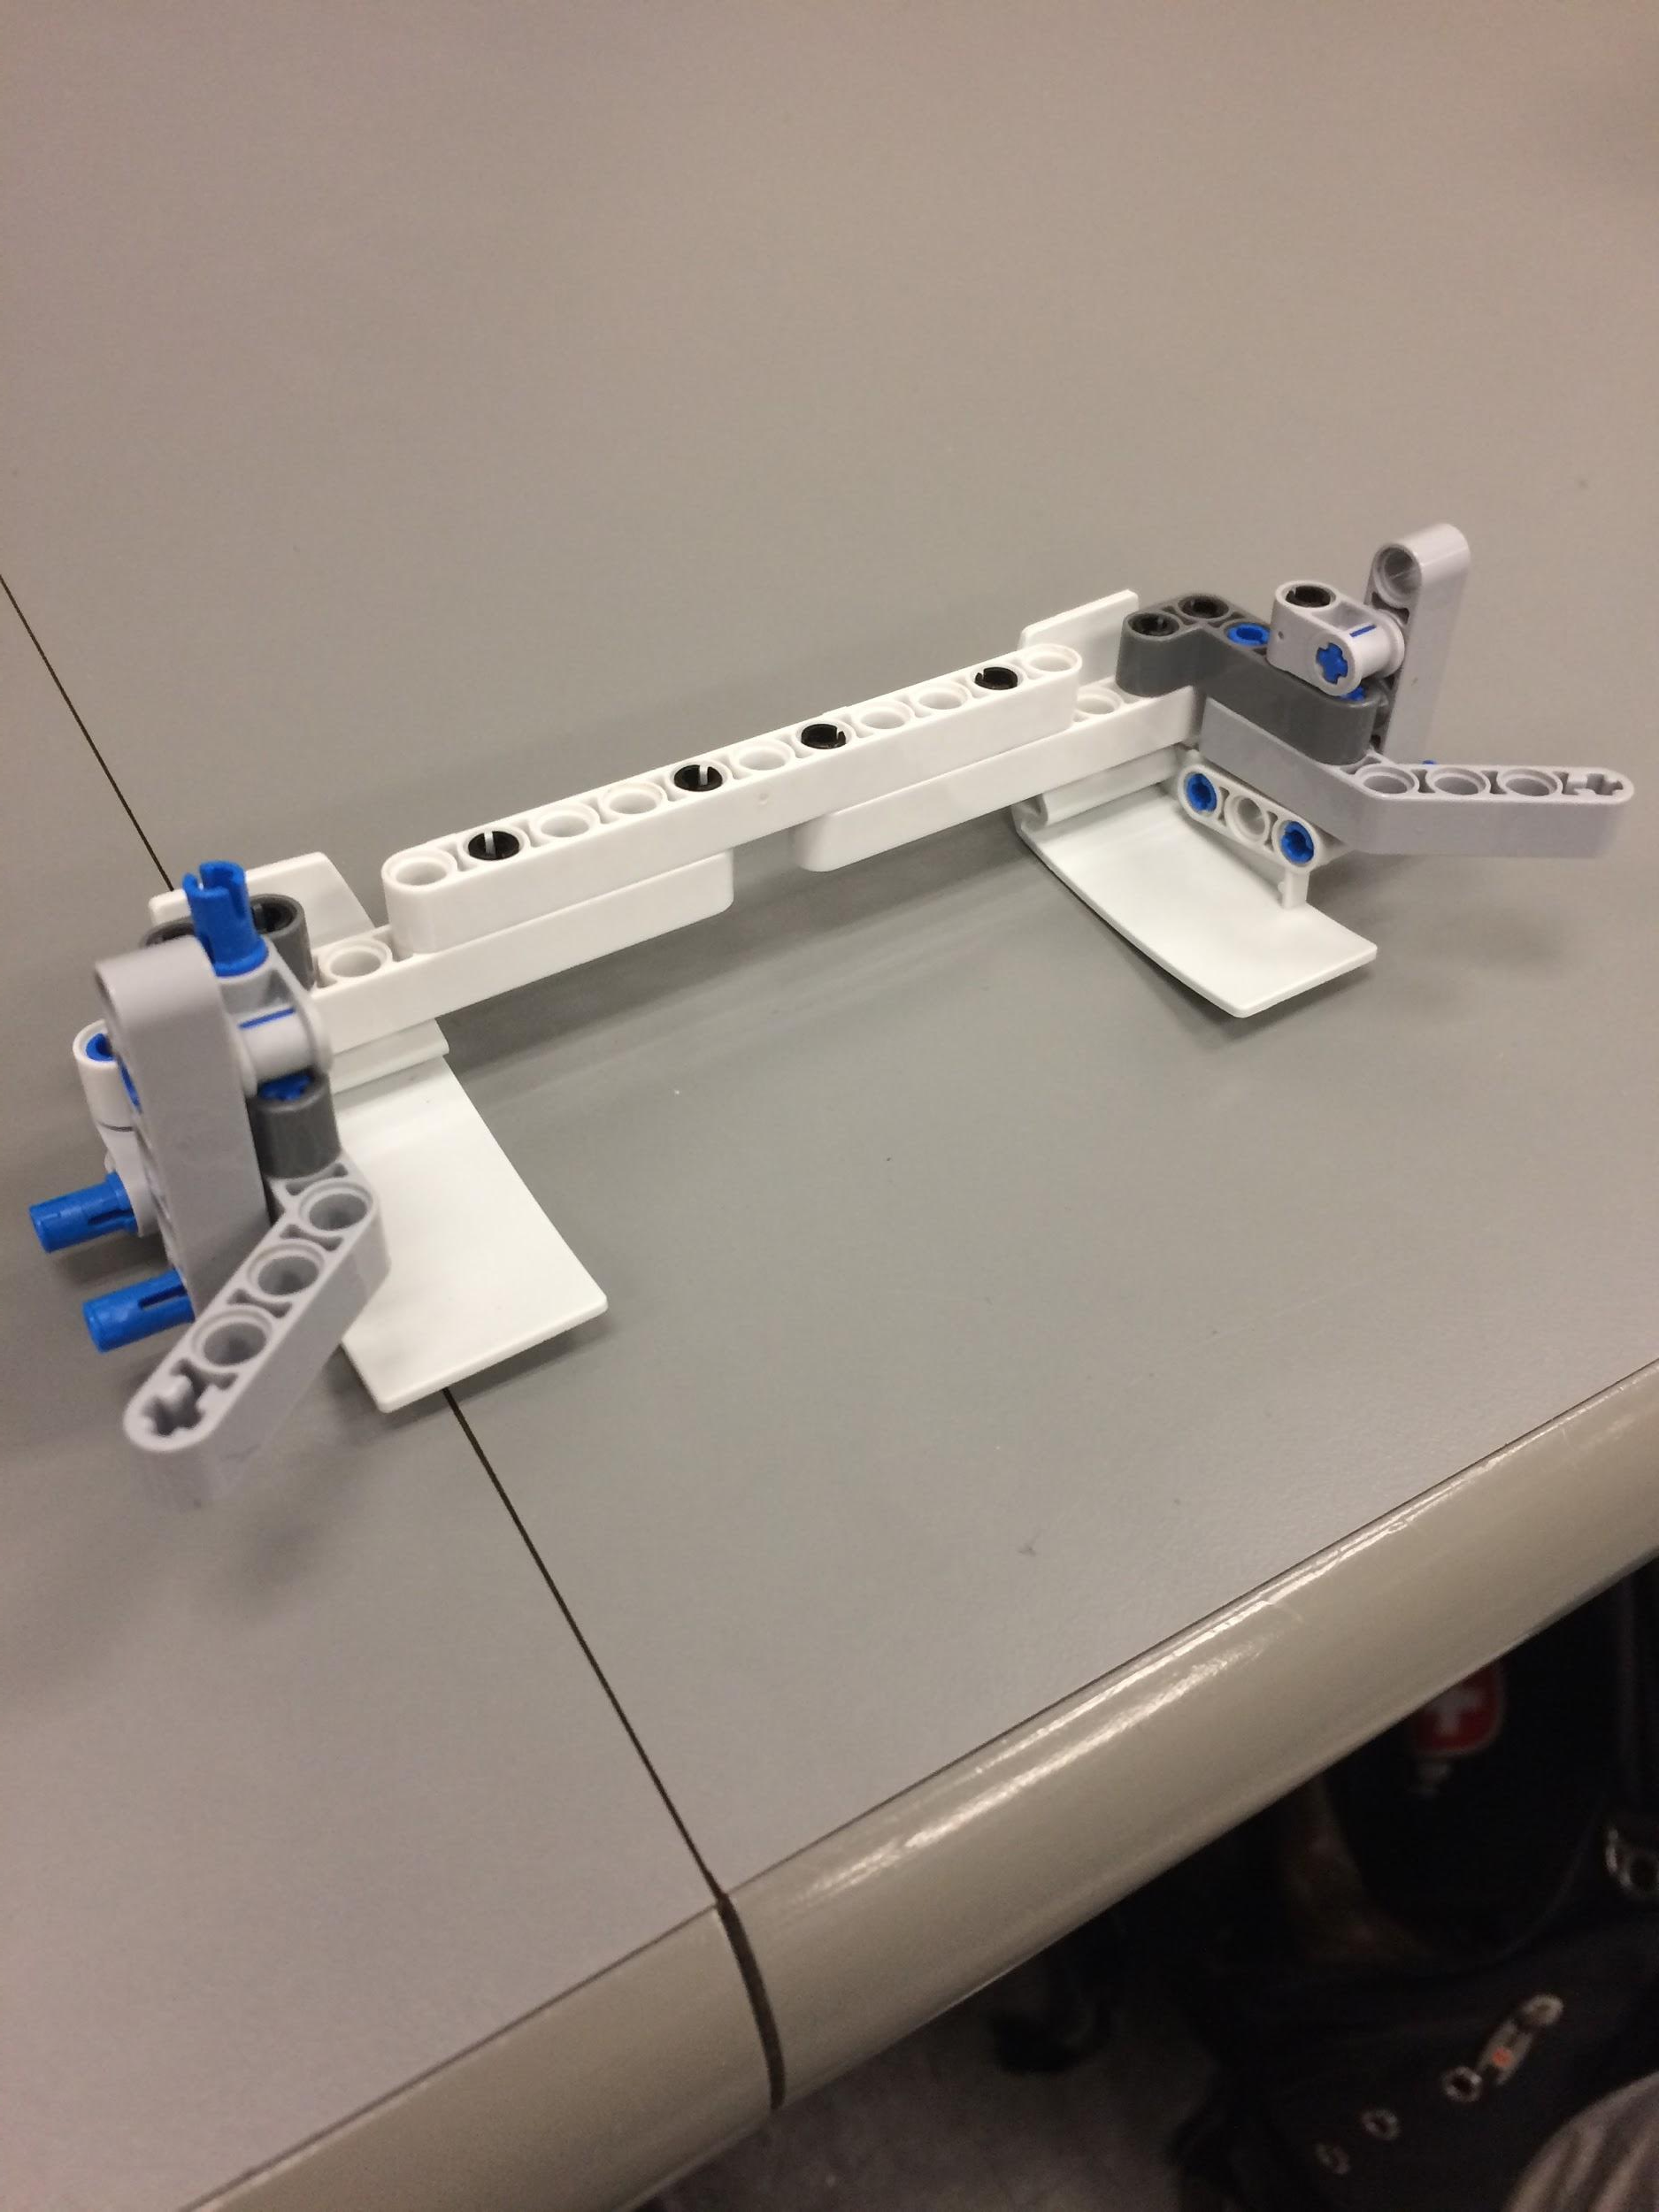
Collectors

Slide 6
Software
WiFi testing
Localization testing
Class hierarchy update
Software development ramps up this week

Slide 7
Testing
Caster gear
Adding a piece of tape improves the friction of the gear
Able to cross over shallower angles of attack with respect to the discontinuity
WiFi
Given code on myCourses works
Localization
Focus on bumping into the wall to get the robot oriented at 0 degrees.
Hardware
Various constructed capture designs tested

